Slide 1

AI Coder: Vibe Coder to Agentic Engineer
The Missing Manual
Week 2
Day 1

Slide 2
3 Weeks to Expert Agentic Coder
Core skills
Products / Features
Projects
Week 3: Agentic Engineering as an expert
Multi-Agents
Sub-Agents
Hooks
Sandboxing
Large Codebase
Workflow
Swarms
Orchestrators
Project 4: Capstone
Week 2: Vibe Engineering as a professional
Claude Code
OpenCode
others
Commands
Checkpoints
Ralph Loops
MCP
Skills
Plugins
Workflows
Team
Debugging
Project 3: SaaS Platform
Week 1: Vibe Coding for fun and profit
Agentic Coding Landscape
Foundations
AGENTS.md
Context
Cursor
Copilot, Codex
Antigravity
Project 1: YOLO
Project 2: Commercial MVP

Slide 3
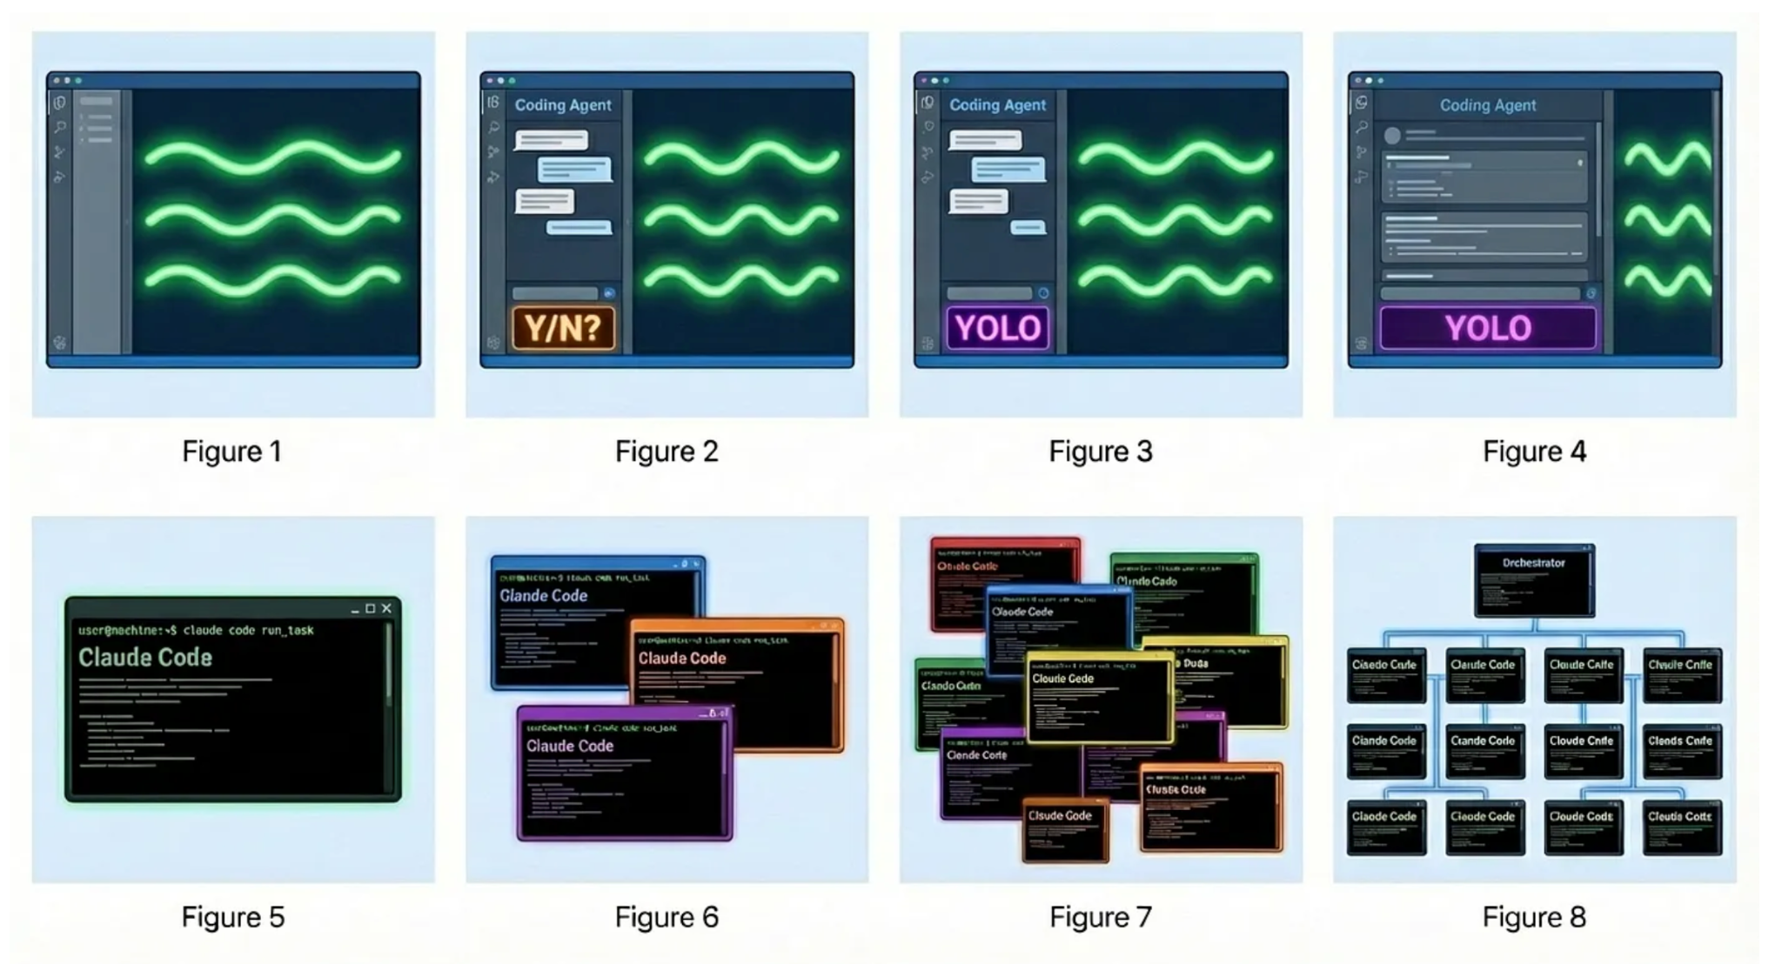
“Evolution of the Programmer in 2024–2026” by Steve Yegge
Stage 1
Stage 2
Stage 3
Stage 4
ChatGPT
AI auto-complete
Coding agent in IDE sidebar, asks permission before changes
Coding agent in IDE sidebar, YOLO mode
Coding agent in IDE main window, YOLO mode, check diffs
Stage 5
Stage 6
Stage 7
Stage 8
Coding agent in CLI, YOLO, diffs scroll by
Multi-agent in CLI, 3-5 agents
10+ agents in CLI manually managed
Agents orchestrate agents

Slide 4
Which approach is right
Mission critical software, large codebase, highly innovative code
Micro- manage, Approve, Frequent resets
Plan, Execute, Review, Test
SDD;
Trust but verify
MVPs, new build, risk appetite, boilerplate code
YOLO
Ralph Loops
Multi- agent
swarms,
orchestrate
Your job is to deliver code that is proven to work

Slide 5
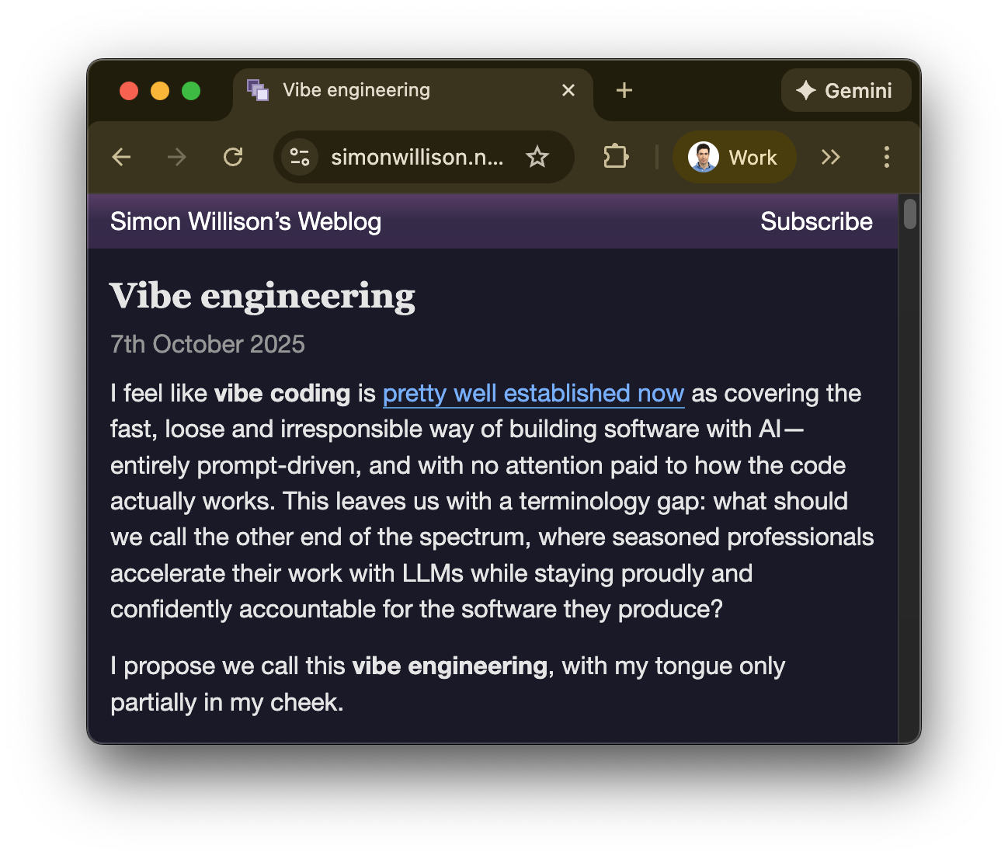
Vibe Engineering

Slide 6
The Rise of Claude Code
Late 2024
Created by Anthropic Engineer Boris Cherny, as a side-project
Apr 2025
General release, the first of the CLI based AI Coding Assistants
Sep 2025
V2 brings VS Code extension, robust ecosystem (checkpoints, subagents, hooks, skills, background tasks, SDK …)
Nov 2025
Opus 4.5 released, considered inflection point; $1B run-rate revenue
Jan 2026
Cowork takes Claude Code beyond Coding (+Open Claw, etc)

Slide 7
3 Weeks to Expert Agentic Coder
Core skills
Products / Features
Projects
Week 3: Agentic Engineering as an expert
Multi-Agents
Sub-Agents
Hooks
Sandboxing
Large Codebase
Workflow
Swarms
Orchestrators
Project 4: Capstone
Week 2: Vibe Engineering as a professional
Claude Code
OpenCode
others
Commands
Checkpoints
Ralph Loops
MCP
Skills
Plugins
Workflows
Team
Debugging
Project 3: SaaS Platform
Week 1: Vibe Coding for fun and profit
Agentic Coding Landscape
Foundations
AGENTS.md
Context
Cursor
Copilot, Codex
Antigravity
Project 1: YOLO
Project 2: Commercial MVP

Slide 8

AI Coder: Vibe Coder to Agentic Engineer
The Missing Manual
40%
Complete

